Slide 1
RESEARCH PROJECT REPORT IN FULFILMENT OF SUMMER INTERNSHIP PROJECT
TOPIC:
GOODS AND SERVICES TAX (GST)
SUBMITTED BY: SUBMITTED TO:
SANIYA USMANI SHASHWAT SINGHAL

Slide 2
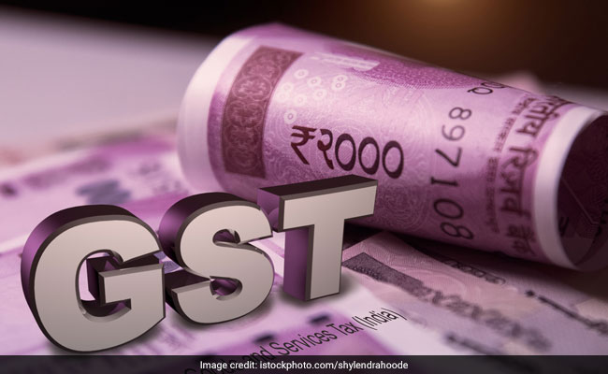
GOODS AND SERVICES TAX(GST)
GST (Goods and Services Tax) means a tax that the government charges on the sale of goods and services.
When you buy something or pay for a service, a small amount is added to the price as GST, and this money goes to the government.
Example:
Mobile phone price: ₹10,000
GST (18%): ₹1,800
Total amount paid: ₹11,800

Slide 3
BACKGROUND OF GST
The ides of GST was first mooted in india by by Kelkar committee in year 2004. Dr. Vijay Kelkar recommended national GST. The constitution (one hundred and first amendment)act, 2016 was passed.
The GST introduced to replace multiple indirect taxes levied by cental and state government.
It was implemented in india on 1 July 2017 through the constitution.

Slide 4
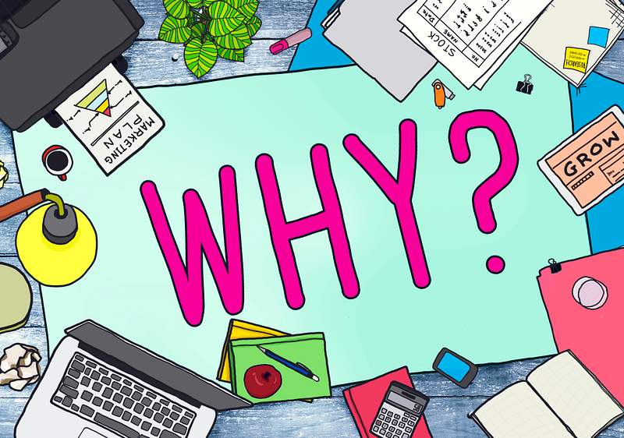
WHY GST
Main Reasons for Introducing GST:
To eliminate multiple taxes
To remove the cascading effect of taxes
To create a unified national market
To simplify compliance
To increase transparency
To improve economic growth
To increase government revenue

Slide 5
TYPE OF GST
Type | Full Form | Collected By | Applicable On
CGST | Central GST | Central Government | Intra-state supply
SGST | State GST | State Government | Intra-state supply
IGST | Integrated GST | Central Government | Interstate supply and imports
UTGST | Union Territory GST | Union Territory Administration | Supplies within Union Territories

Slide 6
ONE NATION ONE TAX
"One Nation, One Tax" does not mean there is only one GST component. It means there is one unified GST system that replaced many different indirect taxes across India.

Slide 7
Why GST has different types?
India is a federal country, meaning:
Central Government collects revenue for the whole country
State Governments need their own revenue too
Union Territories are separately administered
So instead of creating separate taxes, GST is split into parts for easy distribution.

Slide 8
1. Same state transaction = CGST + SGST
When you buy something within the same state, tax is divided:
👉 Example:
You buy a shirt in Prayagraj (UP) for ₹1,000
GST = 18%
CGST = 9% → ₹90 (Central Government)
SGST = 9% → ₹90 (UP Government)
👉 Total tax = ₹180
✔ Same tax system
✔ Just divided between Centre and State

Slide 9
2. Different state transaction = IGST
When goods move between states:
Example:
You buy a laptop from Delhi online, delivered to UP
GST = 18% = IGST ₹1800 (on ₹10,000)
Government handling:
Centre collects IGST first
Then shares part with UP
✔ No confusion between two states
✔ One single tax collected

Slide 10
3. Union Territories = UTGST
In Union Territories, there is no state government.
Example:
Buying something in Chandigarh
CGST + UTGST applied instead of SGST
Because UTs don’t have their own state tax system

Slide 11
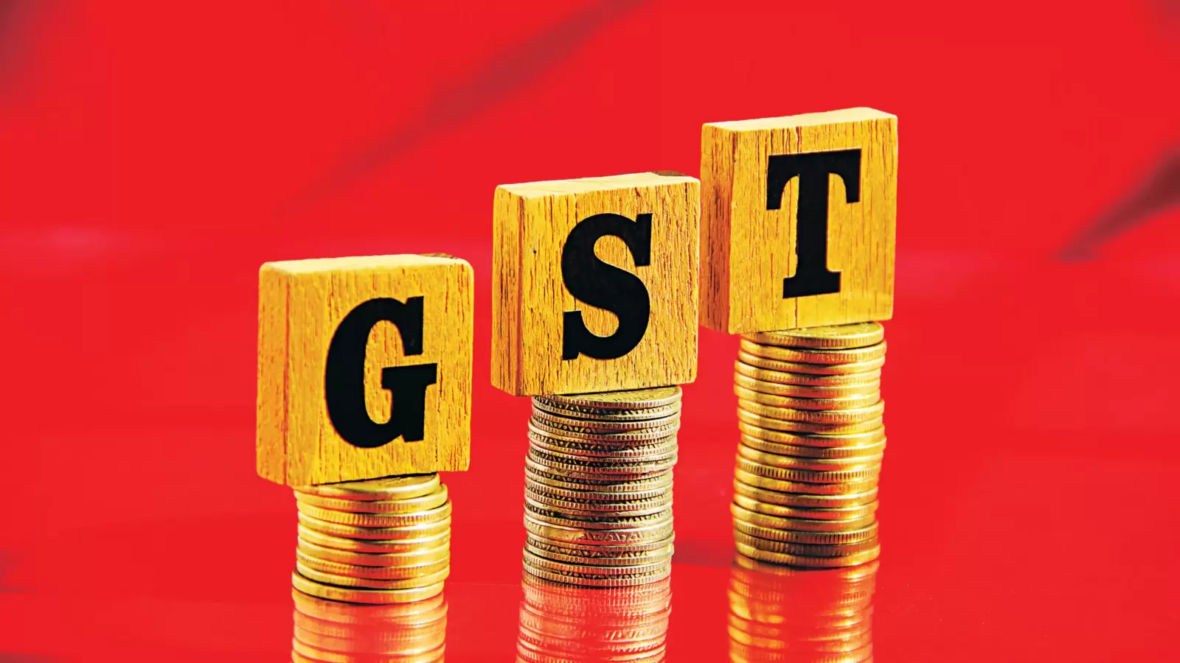
CONCLUSION
GST (Goods and Services Tax) is a unified tax system introduced in India to replace multiple indirect taxes and simplify the taxation process. It is called “One Nation One Tax” because it brings all major taxes under a single framework and applies common tax rules across the country. Although GST has different types like CGST, SGST, IGST, and UTGST, these exist only to ensure proper distribution of tax revenue between the Central Government, State Governments, and Union Territories. Overall, GST has made the tax system more transparent, organized, and easier for businesses and consumers.

